Slide 1
Embracing Public Sentiment: A New Dimension in Equity Portfolio Management
Akhil Nagabhyiru , Dhrithi Pradeep Alva, Surya Kalva, Uday
BIA 660 A - Team 5

Slide 2
Objectives
Leverage public sentiment analysis to identify emerging trends and market shifts
Detect early warnings about market changes and potential crises
Augment technical analysis with granular sentiment analysis on each equity for a robust risk management strategy

Slide 3
Data Collection and Preprocessing
Web scraping was employed to collect data related to many different companies from two different sources, i.e., the Hindenburg Research website and Yahoo News.
To parse the HTML content of the website and extract the relevant information, the Beautiful Soup library was used.
Once the data was collected, the text content was preprocessed by converting all the text to lowercase to avoid any discrepancies due to casing. Special characters and punctuation marks were removed to obtain a clean text corpus.
Stopwords, i.e., commonly used words that do not carry much meaning, were filtered out using the NLTK library.

Slide 4
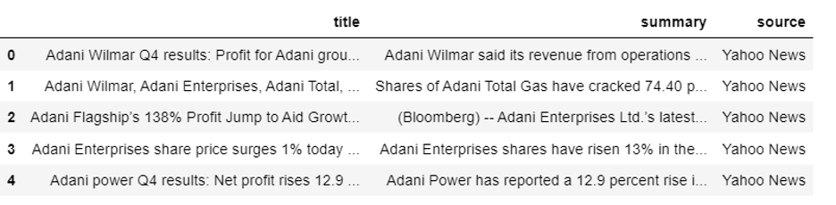
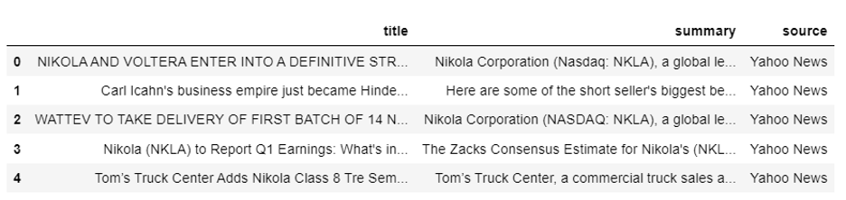
The below data scraped from Yahoo News for Adani and Nikola . Similarly we can check for other companies with our code.

Slide 5
EDA (Exploratory Data Analysis:)
In this particular project, the EDA focused on several aspects related to the text data collected from the Hindenburg Research website and Yahoo News:
Identifying the most common words within the text.
Visualizing the distribution of words using word clouds.
Performing sentiment analysis on the text.
Most Common Words

Slide 6
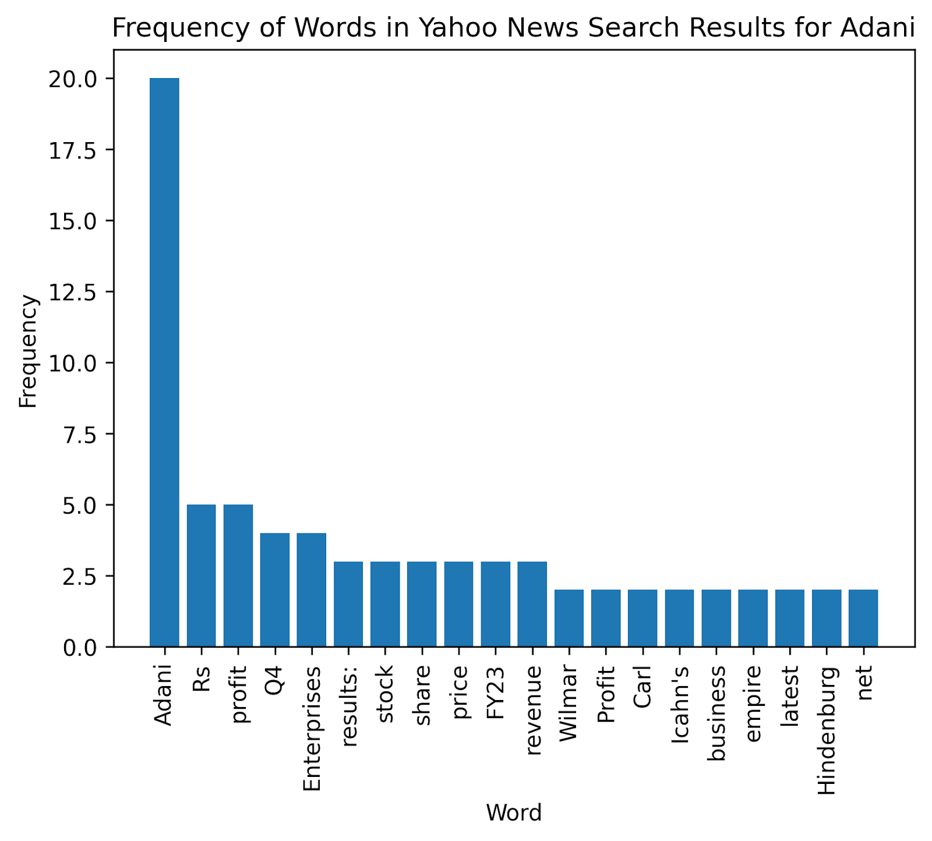
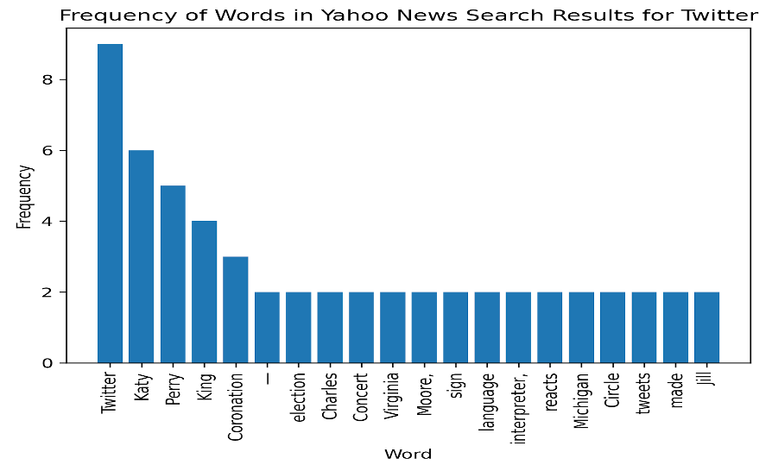
EDA-Frequency of Words In Yahoo News Search For Adani and Twitter

Slide 7
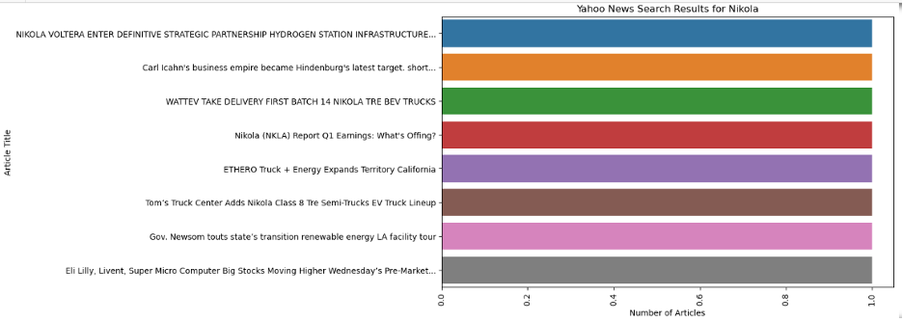
EDA
Our code scrapes for news articles related to companies of our interest, removes stop words from the titles and summaries, and creates a countplot of the article titles for each company. The resulting plot is displayed for each company. The countplot displays the number of articles for each unique title in the scraped data.

Slide 8
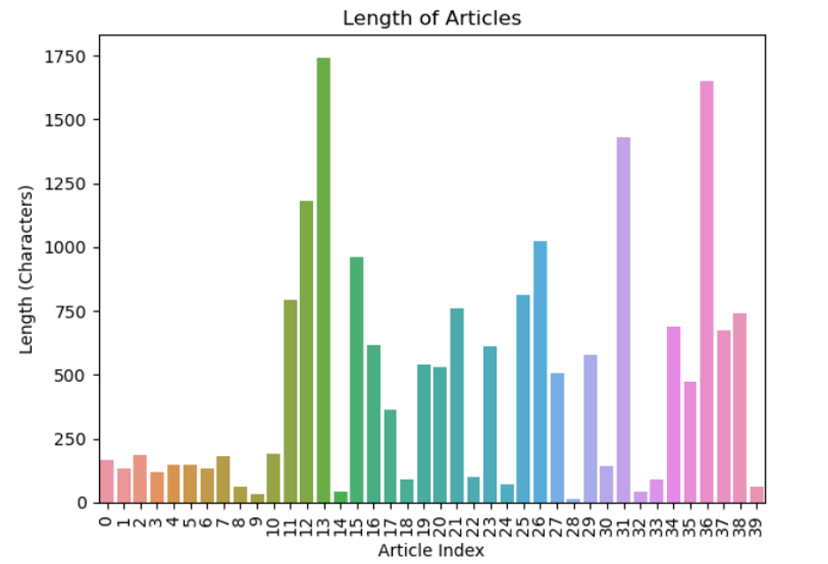
Review Analysis
It is observed that, Average length of articles: 1149.841

Slide 9
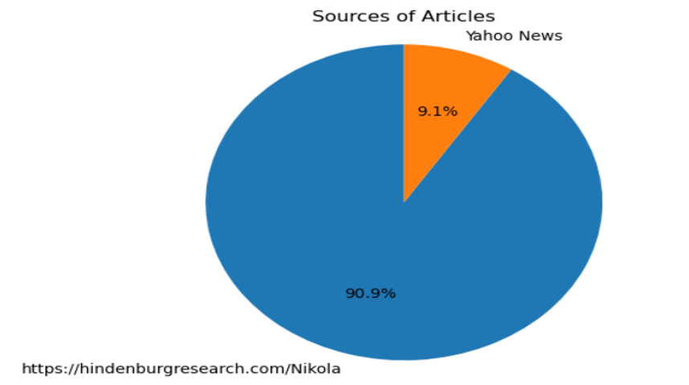
The distribution of sources for the articles in the dataset is visualized using a pie chart.
The pie chart displays the percentage of articles from each source, and the labels show the name of the sources.
The `autopct` parameter formats the percentages to one decimal place. The `axis('equal')` line ensures that the pie chart is drawn as a circle.
This Image is for a Company Nikola

Slide 10
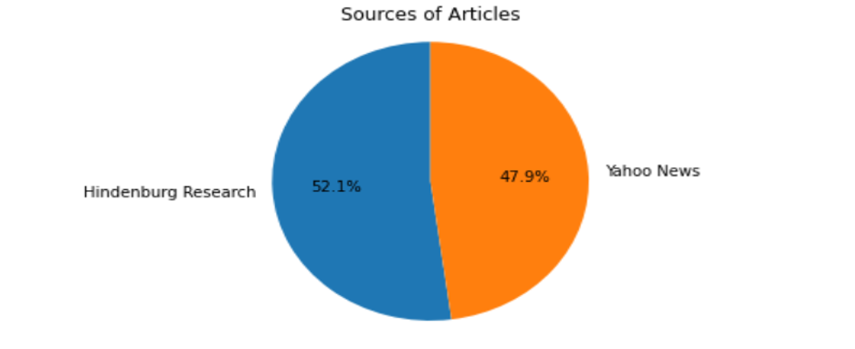
Here is another pie chart that visualizes the proportion of articles from different sources in a given dataset. It uses the value_counts function to count the number of articles from each source, then creates a list of labels and sizes from the resulting dataframe and creates a pie chart using these labels and sizes.

Slide 11
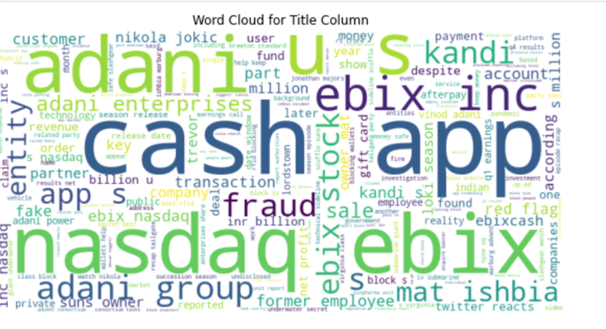
Word Clouds
Word clouds are a graphical representation of the most frequent words in a text, where the size of each word represents its frequency.
Python libraries such as word cloud and matplotlib were used to create these visualizations, which provide a quick and intuitive understanding of the main topics discussed in the text.

Slide 12
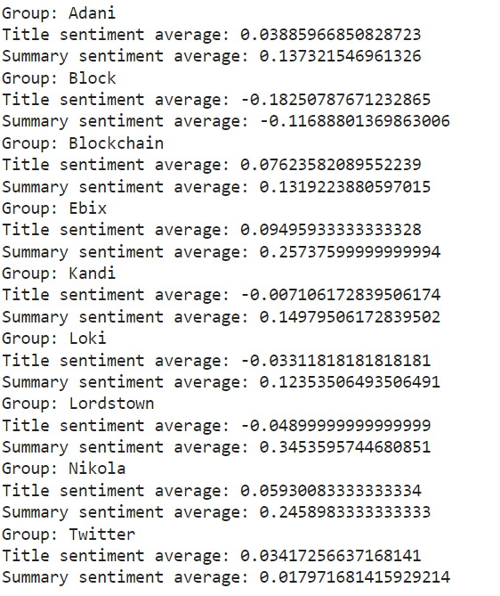
Results
NLP Vader Lexicon
This code groups the data by the company column and counts the number of articles for each company.
Then, it loops over the groups and creates a new dataframe for each group. For each group, it calculates the average sentiment score for both the title and summary columns using the `get_sentiment_scores` function.

Slide 13
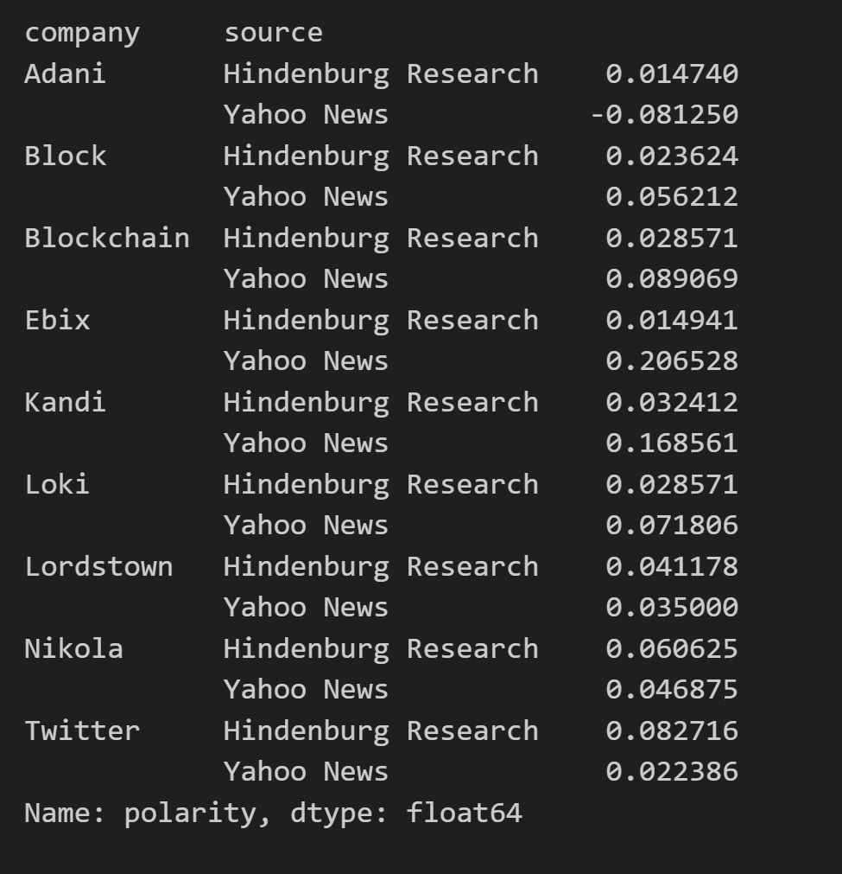
Results
NLP MultinomialNB
Our code performs sentiment analysis on a dataframe `df` containing news articles by using the TextBlob library to calculate the polarity of the summary for each row.
The polarity values are then classified into positive, negative, or neutral using scikit-learn's CountVectorizer and a naive Bayes classifier. The user can then enter a new sentence to get the predicted sentiment using the same classifier and vectorizer.
Where 0 = Neutral, >0=Positive, <0 = Negative.

Slide 14
Further Improvements
To improve the sentiment analysis model, there are a few approaches you can take:
Increase the size and quality of the training data: A larger and more diverse dataset for training can improve the accuracy and robustness of the model.
Fine-tune the model: Fine-tuning involves training the model on a smaller, domain-specific dataset to improve its performance on a specific task.
Incorporate more advanced techniques: More advanced techniques, such as deep learning or reinforcement learning, can be used to improve the accuracy of the sentiment analysis model.
Use a pre-trained model: There are pre-trained sentiment analysis models available that can be fine-tuned or used directly for specific tasks.
As for alternatives to the current model, there are many other libraries and frameworks available for sentiment analysis, including VADER, Stanford CoreNLP, and spaCy. Each library or framework has its own strengths and weaknesses, so it's important to choose the one that best fits your specific use case and requirements.

Slide 15
Future Developments
Employ web scraping tools to extract relevant data from financial news websites, and social media platforms
Utilize cutting-edge NLP techniques such as recurrent neural networks, transformers and hyperparameter tuning
Analyze and process textual data from various sources to derive sentiment scores
Employ machine learning and deep learning techniques to classify and score sentiment data
Employ advanced visualization techniques, such as heatmaps, network graphs, and sentiment score plots
Leverage cloud-based solutions and distributed computing technologies for scalability
Containerization technologies like Docker to package and deploy the project's components
Ensure the project remains efficient and reliable as data volume and complexity increase
Adapt to changes in market conditions, data sources, and investment strategies
Incorporate feedback and new insights to continuously enhance the project's effectiveness

